Slide 1


Football Data WareHouse
By Mattia Maucione
ID: 2007209

Slide 2
Motivation & objective
Project Description:
This project focuses on the development of a Data Warehouse to analyze the factors that influence the market value of professional football players across the top five European leagues (Serie A, Premier League, La Liga, Bundesliga, Ligue 1). It integrates two datasets: player performance statistics (2018–2024) and market valuations (2000–2024), harmonized through structured ETL operations.
Objective
Build a unified and consistent analytical base using a Dimensional Fact Model and a star schema in PostgreSQL, enabling detailed analysis of player valuation trends based on age, performance metrics, league, club, and role. The project includes data preparation, schema design, and statistical analysis performed with SQL and Python.

Slide 3
Datasets Overview
In this project I join two datasets.
Performance dataset (2018-2024):
Offensive metrics (goals, assists, xG, key passes)
Defensive metrics (tackles, interceptions, blocks)
Possession and passing data (passess completed, progressive carries)
Separative CSVs for each aspect (player_defense.csv, player_shooting.csv)
Each row represents a player-season pair, and includes team, league, and season metadata.
Valuations dataset (2000-2024):
Player name, date of valuation, and market value in euros
Club, competition (league), nationality, and birth year
Data harmonized with the performance dataset through ETL operations (based on name, season, and club).

Slide 4
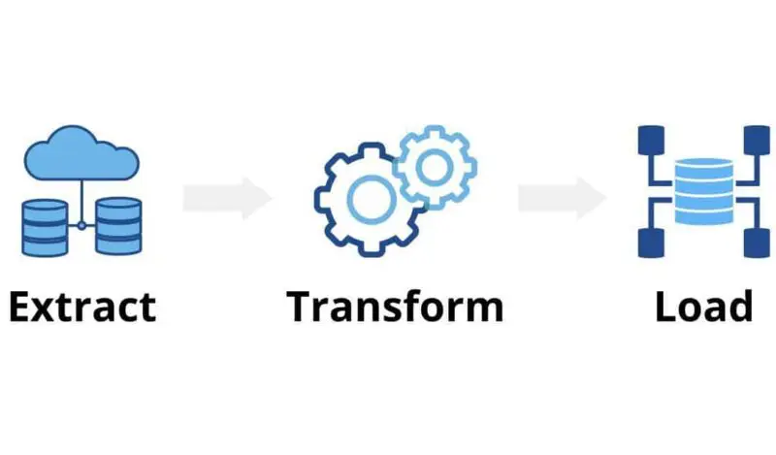
ETL Process - Overview
3 phases:
Extract: Multiple CSVs (performance and valuation)
Transform: Cleaning, matching, filtering
Load: Final CSVs imported into PostgreSQL for DW creation
Extract phase:
Collected multiple datasets from two sources:
Dataset 1: Player performance statistics split into multiple CSVs (player_defense, player_gca, player_misc, player_shooting, player_possession, player_passing_type, player_passing, player_standard_stats).
Dataset 2: Player valuation data with supporting metadata (players.csv, clubs.csv, competitions.csv).

Slide 5

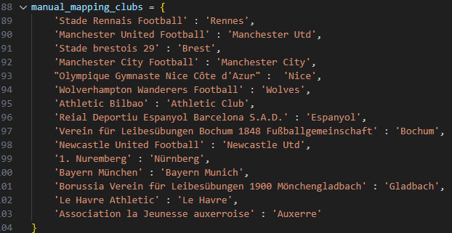
Transform Phase
Data cleaning:
Standardized column names and formats across all CSVs.
Converted all dates to YYYY format (e.g., valuation_date -> year).
Cleaned up string inconsistencies in player and club names.
Removed rows that had missing critical identifiers (e.g., missing player names).
Player Matching & Enrichment
Substituted player_id in the valuation dataset with full player names (first_name + last_name).
Used the players.csv file to fill missing fields like:
nation from country_of_citizenship;
country from country_of_birth;
born from date_of_birth (converted to year only)
Handled cases where names were mismatched due to formatting (e.g., only surname or extra spaces).
Club Name Normalization
Resolved inconsistent club names between dataset 1 and dataset 2 using:
Manual mapping for known mismatches (e.g., Manchester United Football -> Manchester Utd).
Fuzzy string matching with fallback logic.

Slide 6
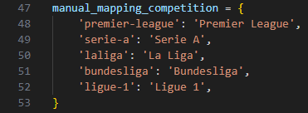
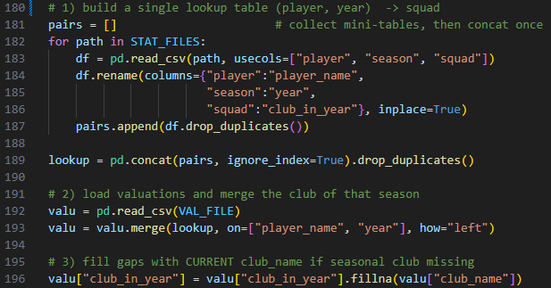
Transform Phase
Competition Name Mapping
Mapped verbose competition names to standardized versions using a manual dictionary.
Dropped rows for competitions outside the top 5 leagues (Premier League, Serie A, La Liga, Bundesliga, Ligue 1).
Enriching Club-Year Information
In dataset 2, added a club_in_year column by:
Searching each dataset_1 file for matching (player_name, season).
Extracting the squad (club name) from the year of interest.
Using fallback to current club if none was found.
Global Missing Value Resolution
Repaired missing values in key fields (born, country, continent, nation, age) using:
Secondary dataset joins (players.csv)
Value inference from same-country rows in other files.
Computed age using season - born.

Slide 7
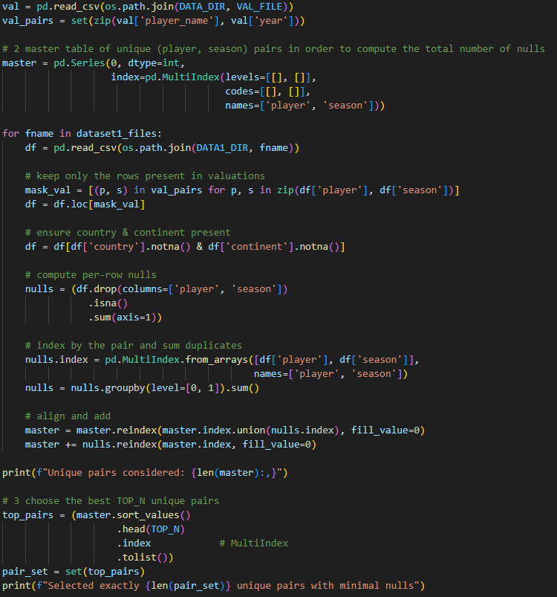
Preparation and Load Phase
Global Pair Scoring
Computed (player, season) pairs present in all stats files and the valuation file.
Counted total missing cells across all stats files per pair.
Selected the 8,000 best player-season pairs with the lowest null count.
Filtering & Export
Filtered every stats file and the valuation file to retain only the top 8,000 pairs.
Ensured all files had identical sets of player-season keys.
Load Preparation
Final CSVs are now clean, aligned, and optimized.
Each file is ready for import into PostgreSQL.
Keys (player, season) can be used to join fact and dimension tables.

Slide 8
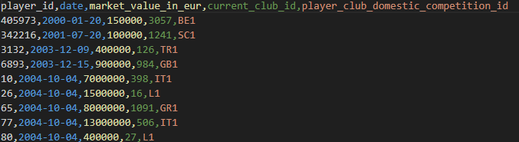
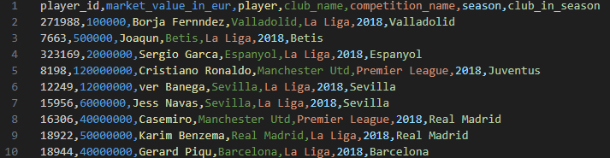
ETL Process – Final considerations
Now we have everything to make a DFM and load to PostgreSQL, in fact we have each file of either dataset 1 and dataset 2 with the same player-season pair and obviously different columns.

Slide 9
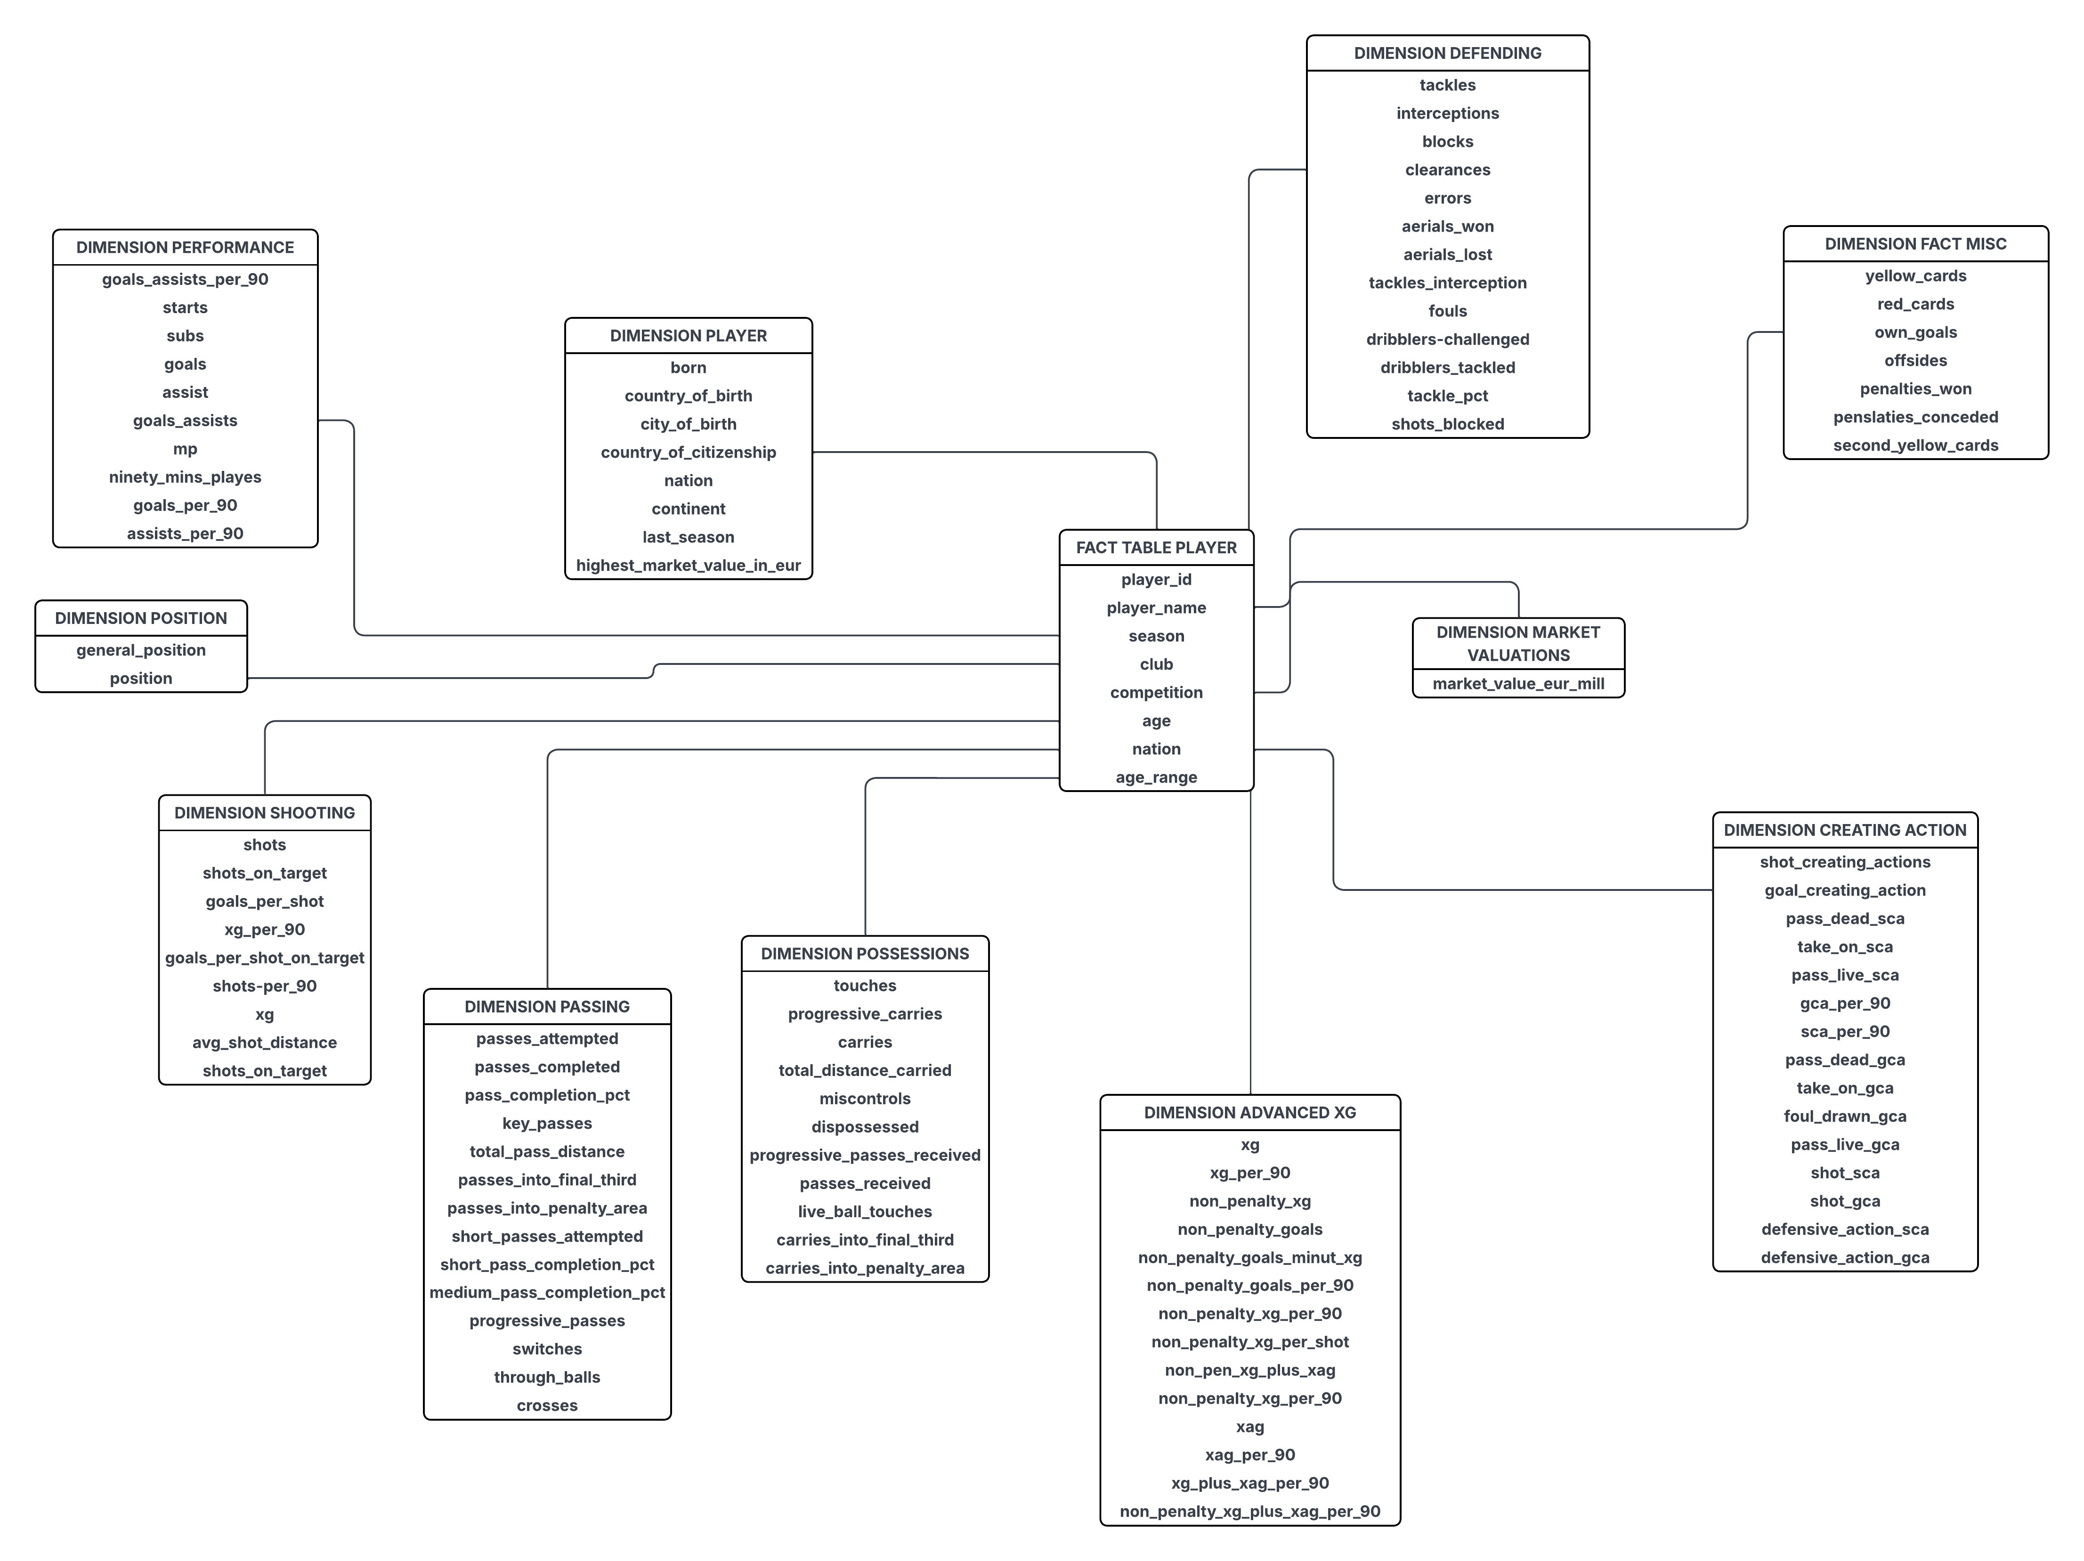
DFM Schema

Slide 10
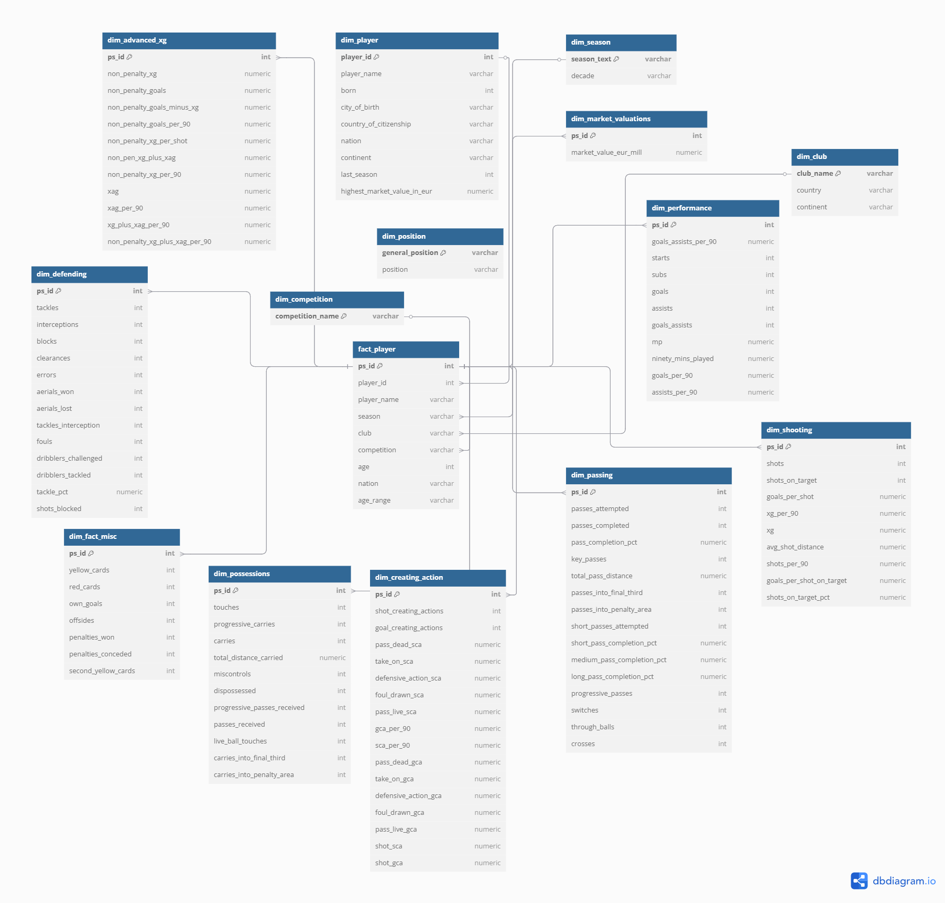
PostgreSQL and Star Schema
• Built on a central fact table: fact_player
• Connected to 4 dimensions:
– dim_player, dim_season, dim_club, dim_competition
• Foreign keys enforce relational integrity

Slide 11
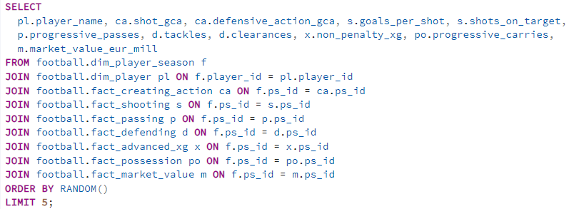

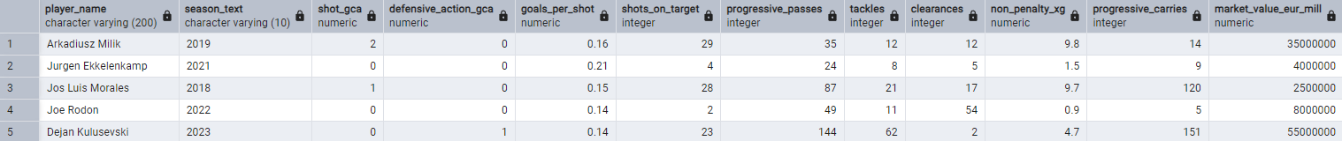
Population of the database
CSV FILES
STAGING TABLES
STAR SCHEMA TABLES
CSV → STAGING TABLES : COPY COMMAND
Example:
\copy staging.stg_players FROM 'C:/Users/matti/Desktop/Data-Warehouse-on-football-data/data/global_selected_8000/selected_players.csv' DELIMITER ',' CSV HEADER;
STAGING TABLES → STAR SCHEMA TABLES: INSERT COMMAND
Example:
Sample Player-Season Records Across Dimensions

Slide 12
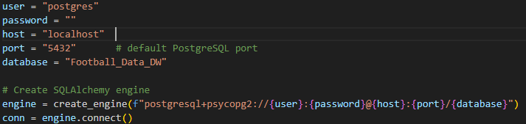
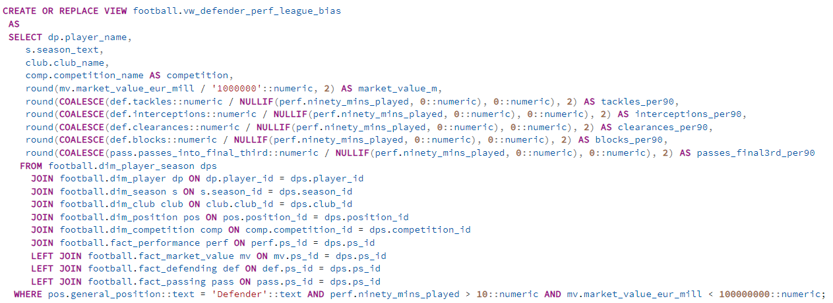
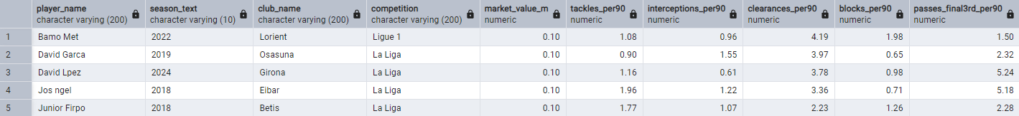
SQL VIEWS USED FOR THE ANALYSIS
Each analysis relies on a dedicated SQL view built on the star schema.
Views encapsulate role-based filters, joined metrics, and precomputed fields.
They ensure consistency, reusability, and clean integration with Python.
Obviously, first of all we have to connect the database and Python. All SQL views were queried directly from Python using SQLAlchemy as the database engine and pandas for data manipulation

Slide 13
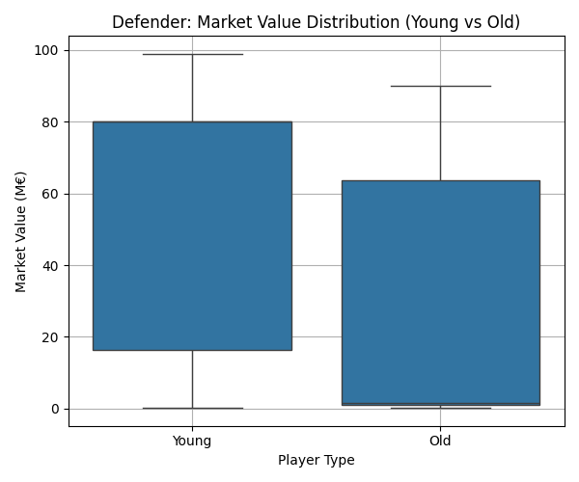
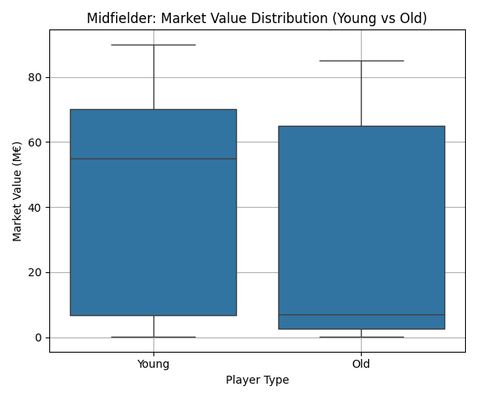
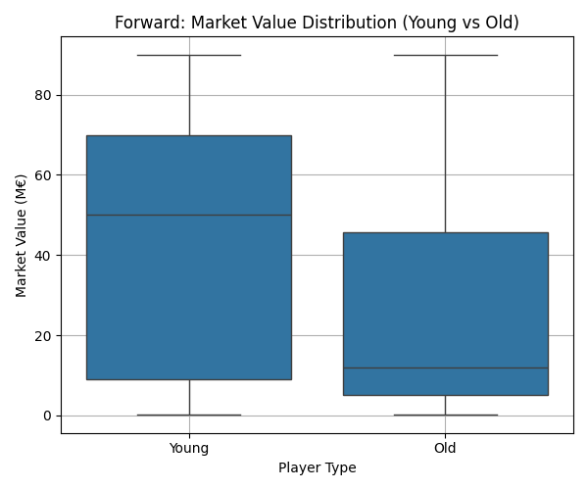
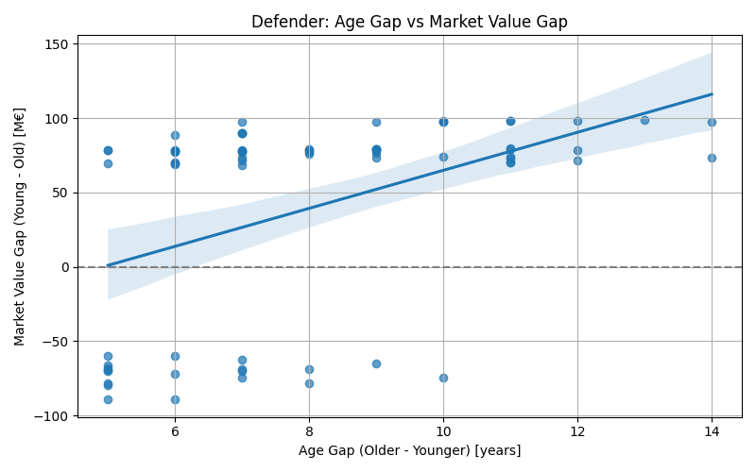
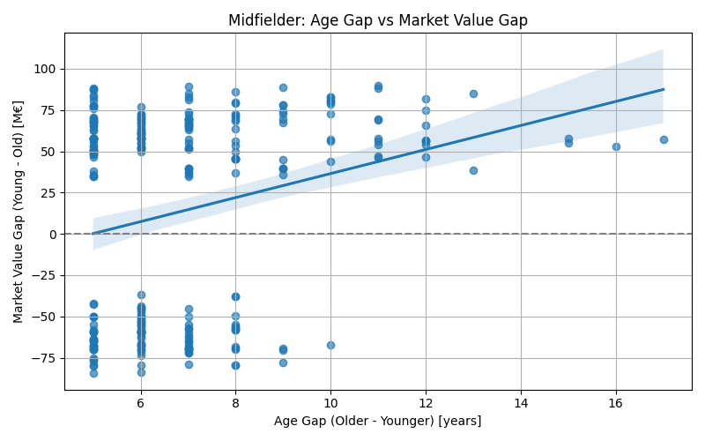
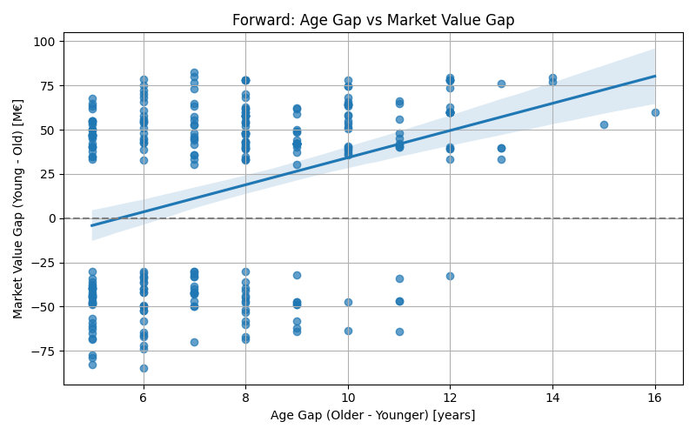
ANALYSIS 1 : AGE vs MARKET VALUE
Goal: Evaluate how age affects market value among similar-performing players
Method:
Selected player pairs with 5+ year age gap and similar stats
Computed age gap and value gap for each pair
Performed linear regression and plotted scatter + boxplots

Slide 14
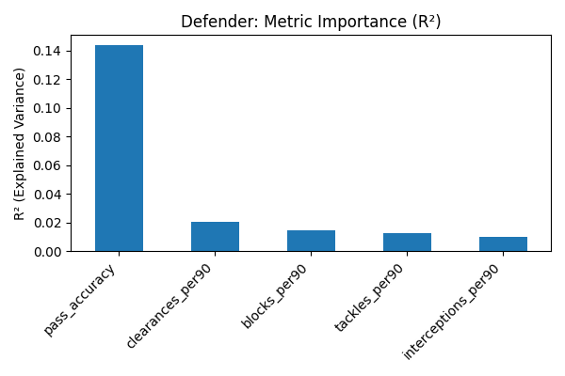
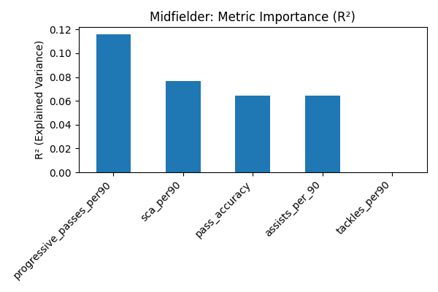
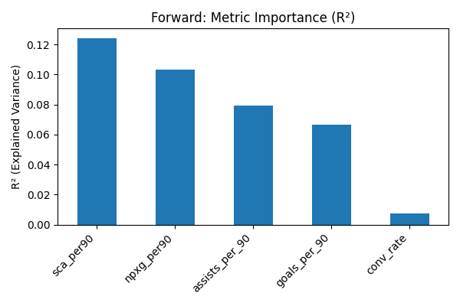
ANALYSIS 2 : Metric Importance by Role (R²)
Goal: Identify which performance metrics most influence value
Method:
Forwards, midfielders, defenders each analyzed separately
Simple linear regression (one metric at a time)
R² values computed and compared across metrics
Note:
Each regression uses OLS and returns an R² value
Higher R² indicates that a metric better explains market value variation

Slide 15
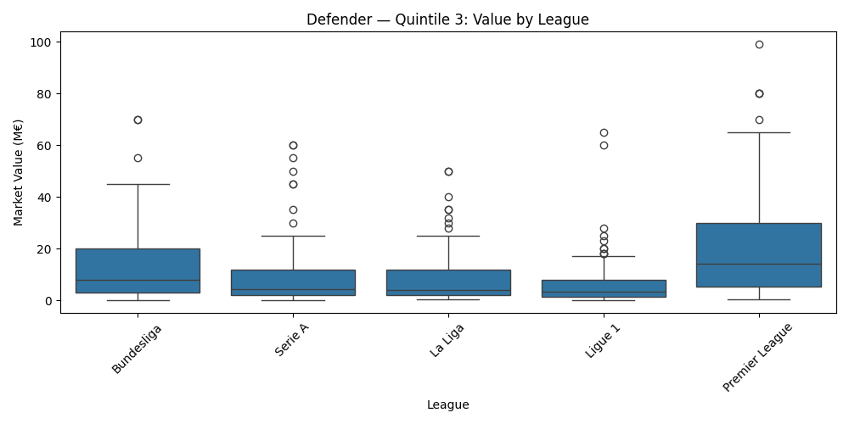
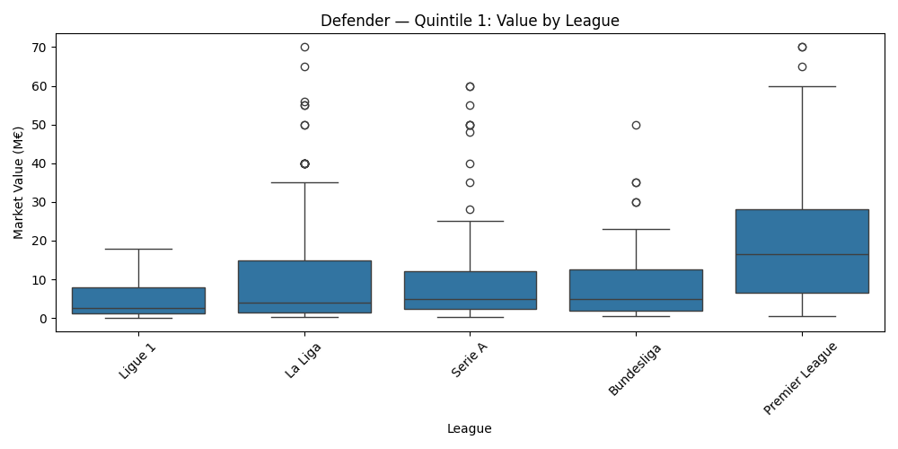
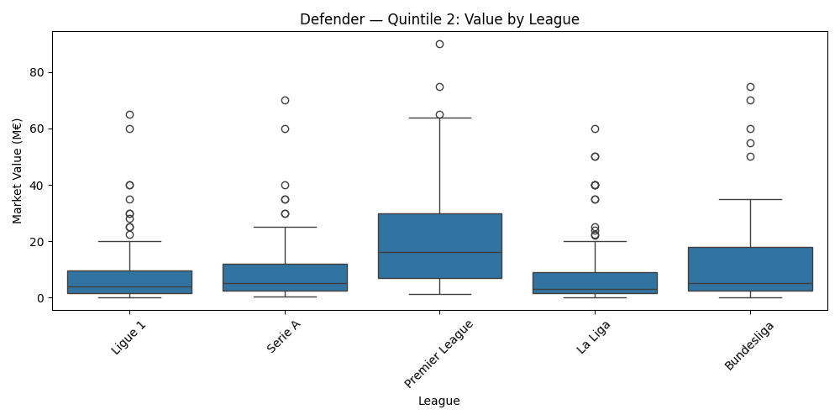
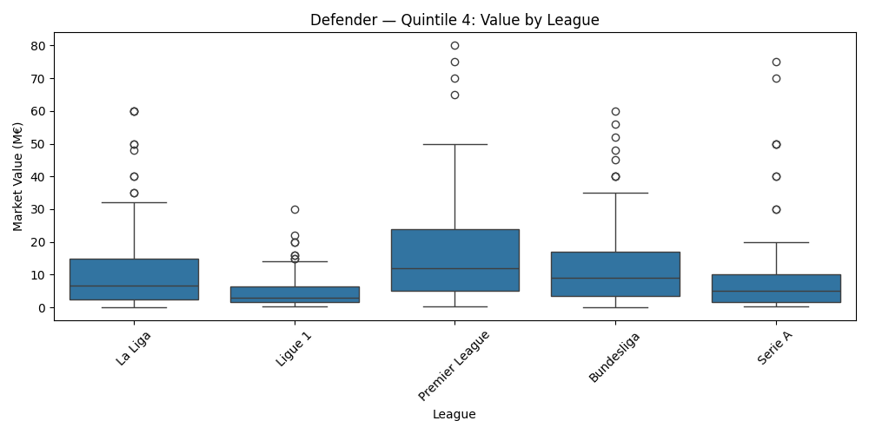
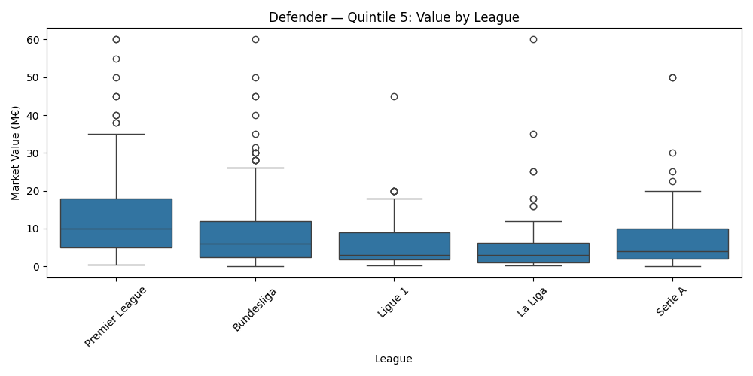
ANALYSIS 3: League Bias
Goal: Detect market valuation bias across leagues
Method:
Composite performance score (z-scores of 5 metrics)
Grouped players into performance quintiles
Compared valuations across leagues using boxplots and regression with fixed effects

Slide 16
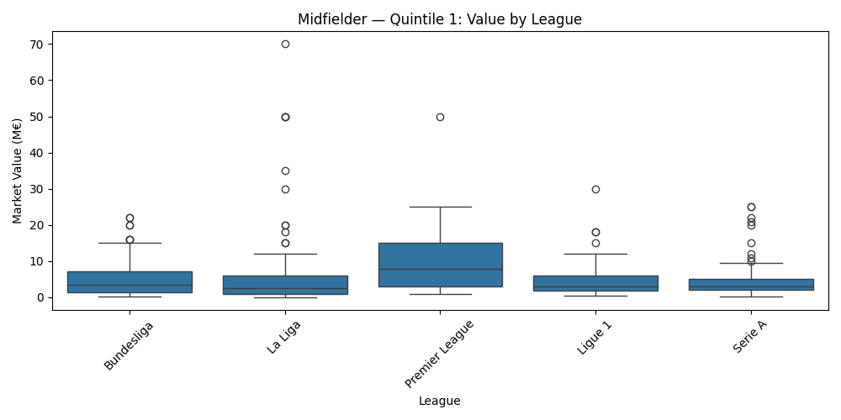
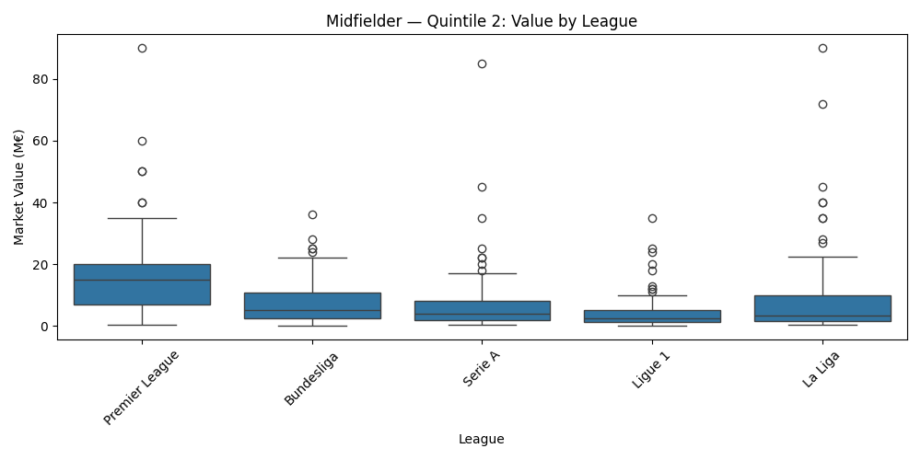
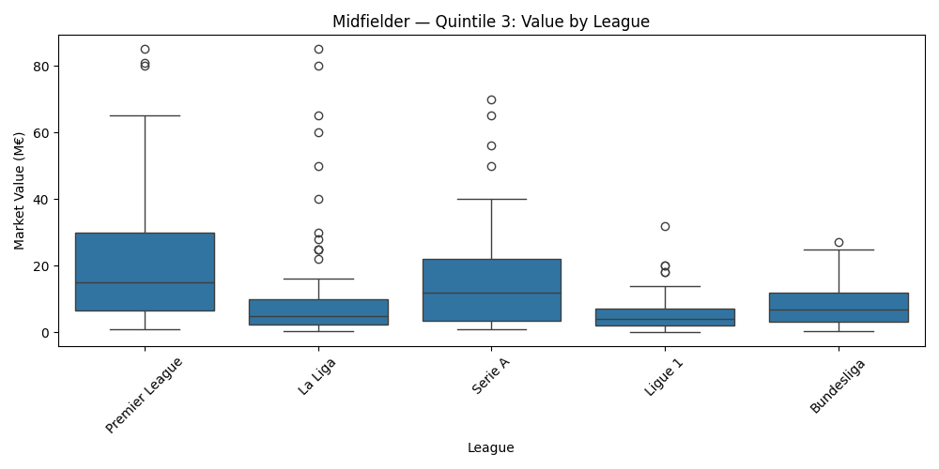
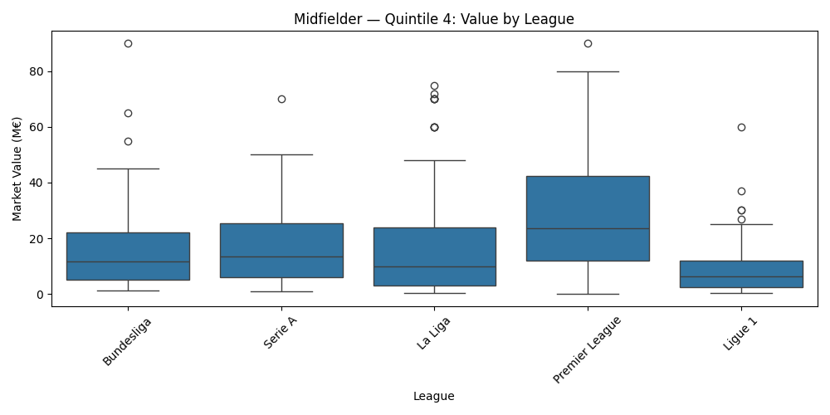
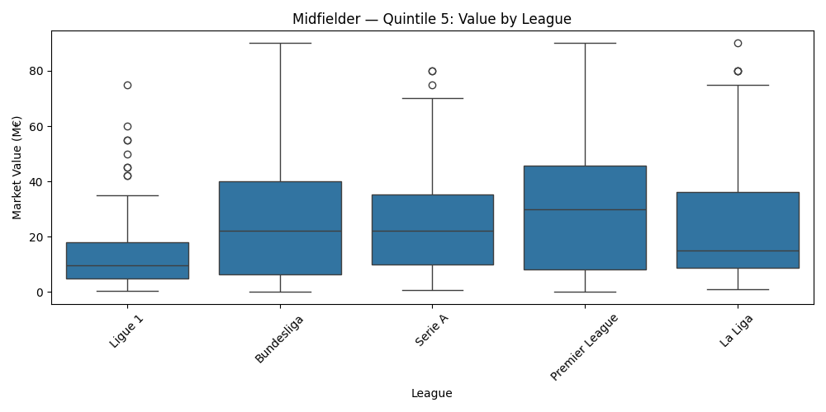
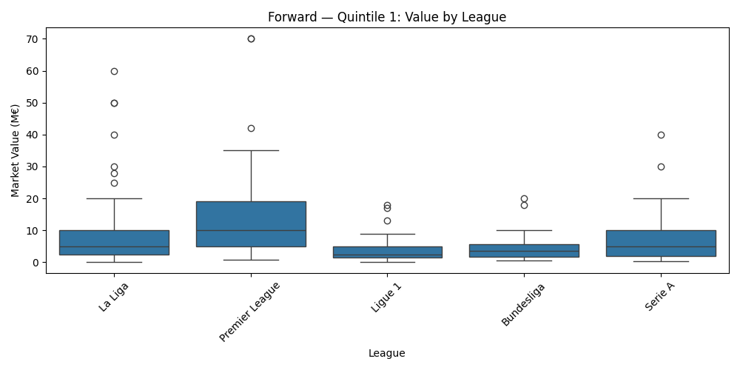
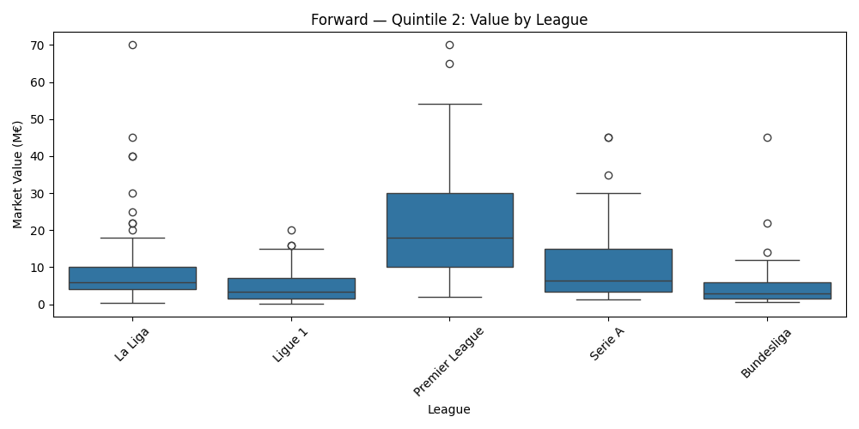
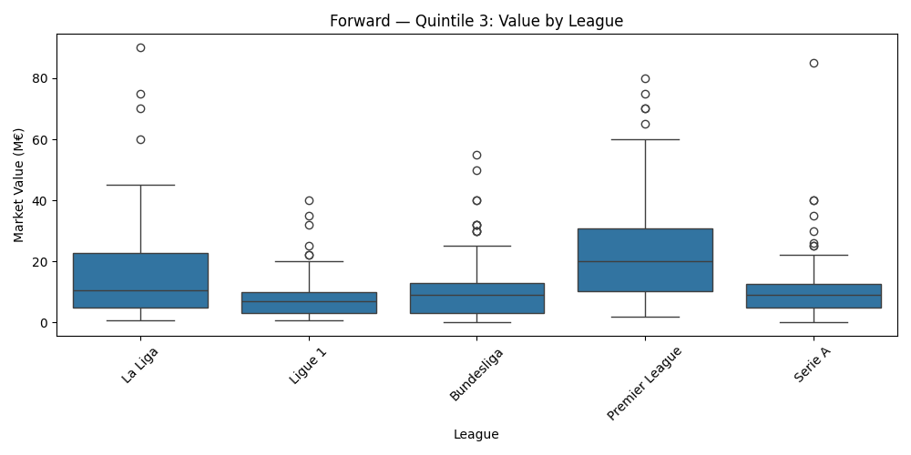
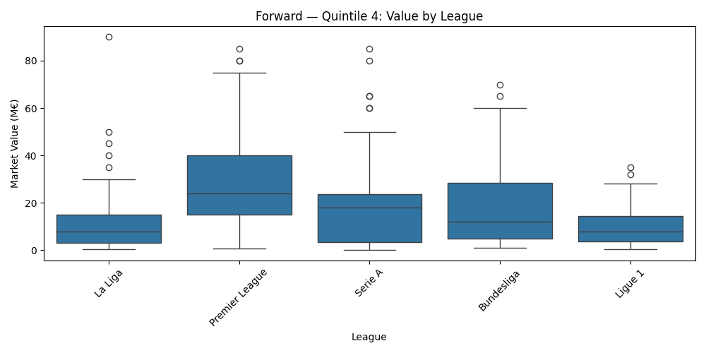
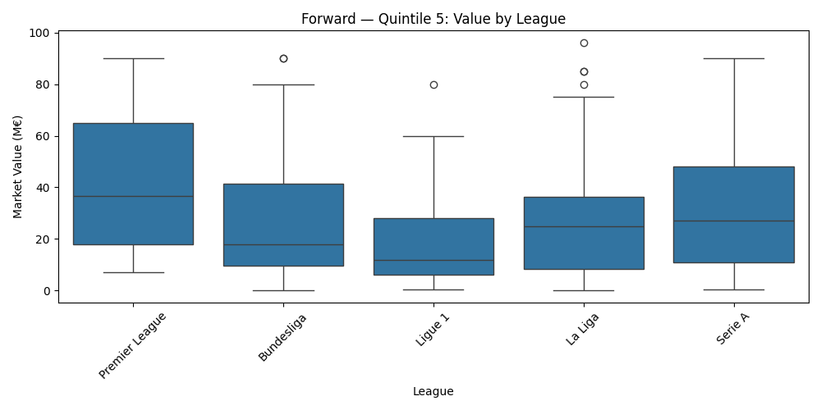
ANALYSIS 3: League Bias

Slide 17
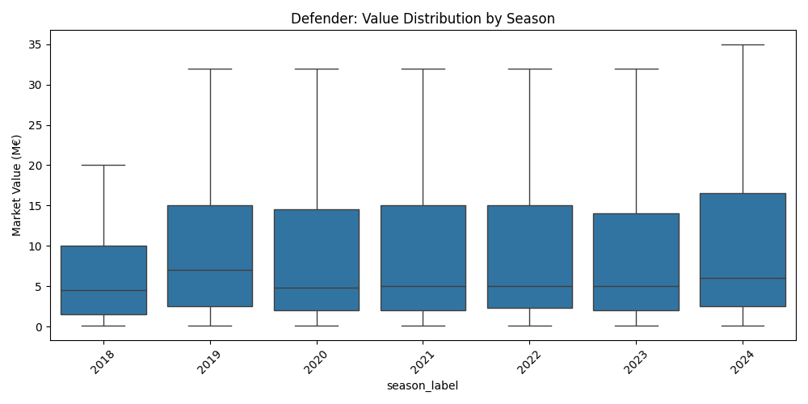
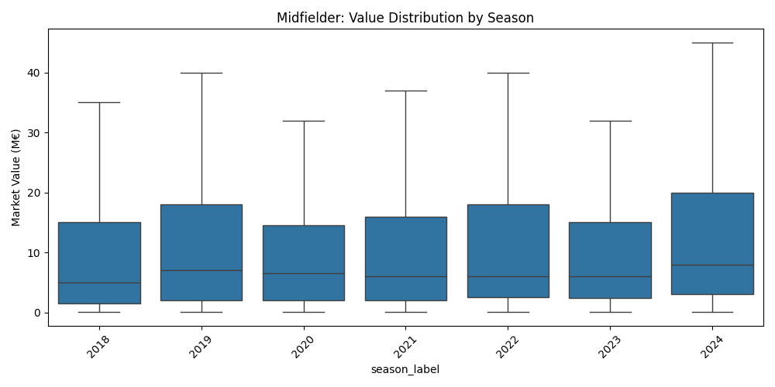
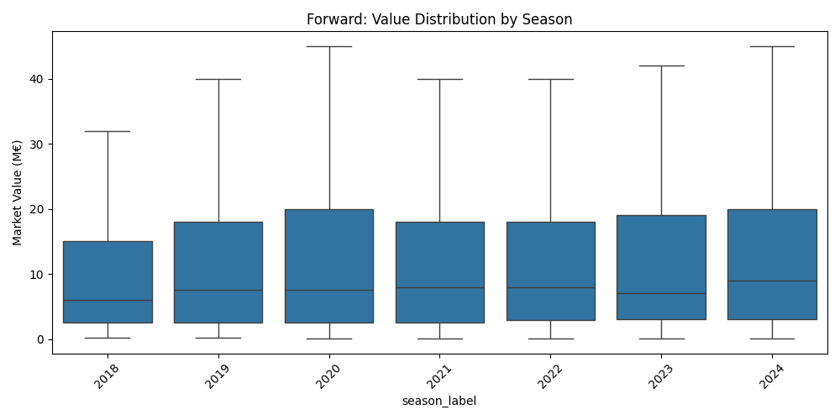
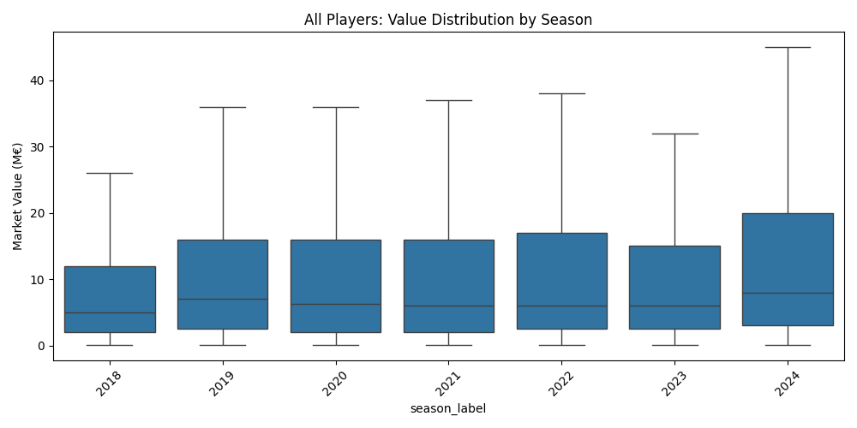
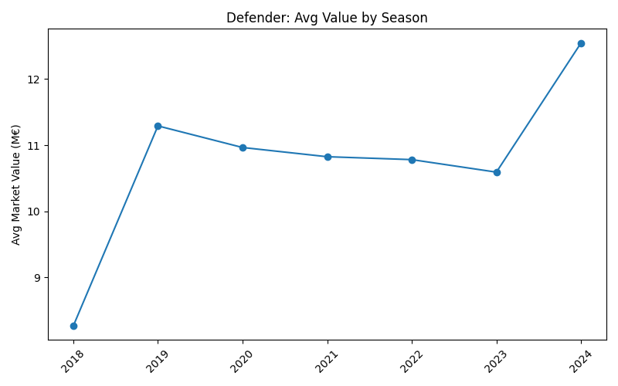
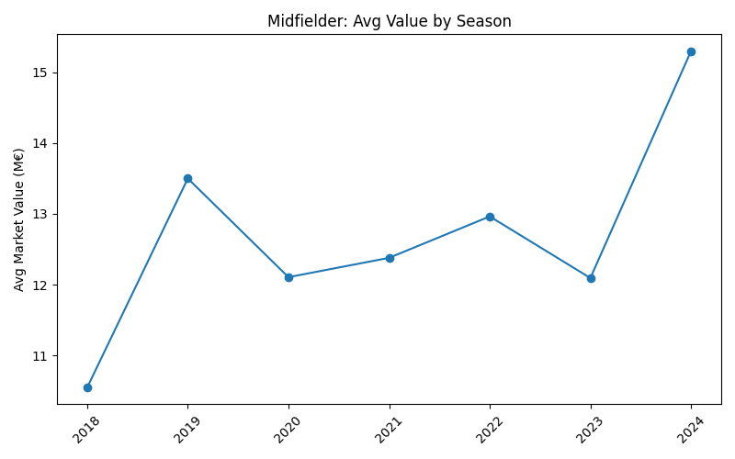
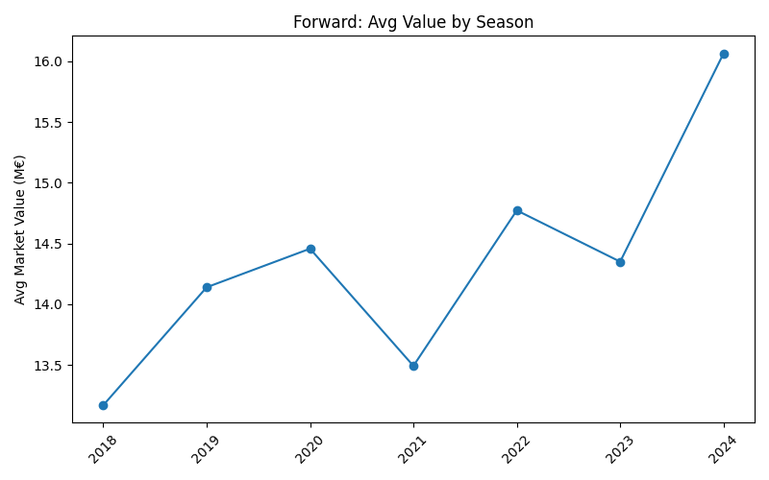
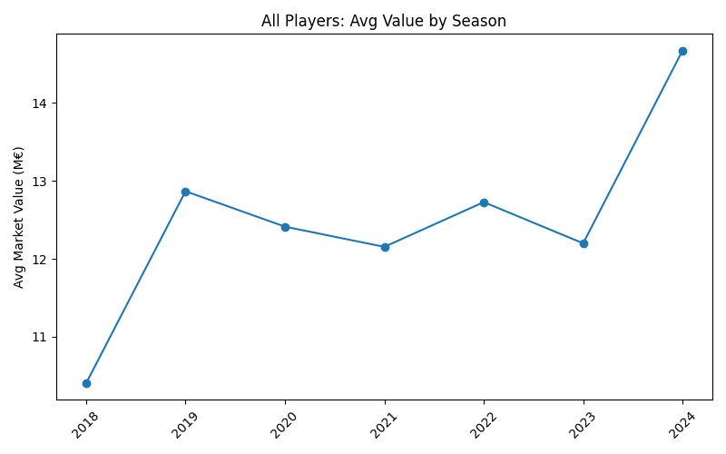
ANALYSIS 4: Market Value Evolution Over Time
Goal: Understand how player value changed from 2018 to 2024
Method:
Aggregated value per season and role
Boxplots and line charts by year
Regression on seasonal fixed effects

Slide 18
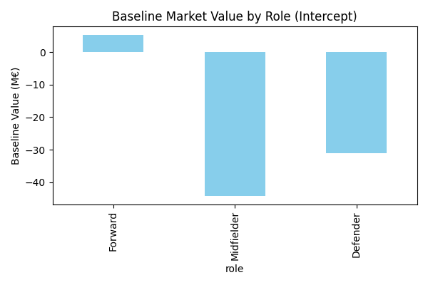
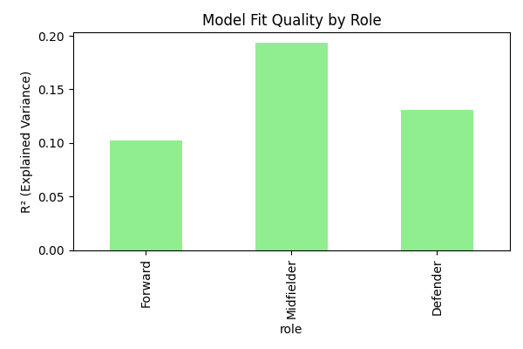
ANALYSIS 5: ROLE-BASED MARKET MODELING
Goal: Model value per role and quantify positional bias
Method:
Regressed value on metrics separately for each role
Collected intercepts and R² to compare baselines
Note:
Intercept shows base market value for the role
R² indicates how well role-specific metrics explain value

Slide 19
CONCLUSIONS
What this project achieved:
Built a complete Data Warehouse pipeline: from raw CSVs to a queryable star schema
Integrated performance metrics and market valuations across top 5 European leagues
Enabled meaningful statistical analysis
Final considerations:
Younger players are consistently overvalued compared to older peers with similar performance
Premier League and La Liga players tend to be priced higher regardless of performance
Positional roles affect baseline valuation, forwards have the highest starting point
Link of the repository: https://github.com/mattia9203/Data-Warehouse-on-football-data.git
Link of the datasets:
https://www.kaggle.com/datasets/conalhenderson/football-data-warehouse/data
https://www.kaggle.com/datasets/davidcariboo/player-scores/data
Tools and references: Pandas - https://pandas.pydata.org/docs/, PostgreSQL - https://www.postgresql.org/docs/ , Matplotlib - https://matplotlib.org/stable/users/index.html
Statsmodels - https://www.statsmodels.org/stable/index.html, SQLAlchemy - https://docs.sqlalchemy.org/, pgAdmin - https://www.pgadmin.org/docs/

